Slide 1
Business Intelligence
Business Intelligence in a modern Analytical Team

Slide 2
Four types of analytics team
Mostly using Excel
Mostly using a coding tool (R, SAS, Python - whatever)
Like #2, but with version control, style and peer review
Like #3, but with good practice from software engineering
Notes:
Those for whom most work is done in Excel, particularly data management and presentation and visualisation of results. Specialist tools like SAS, Stata, Matlab, R or E-views used only for statistical/econometric modelling tasks that are beyond Excel.
Those for whom most work, including data management and visualisation, is done in a coding language which is usually one of R, SAS or Python plus SQL, but version control is limited to copies of files and date-stamped naming conventions.
Like #2, but with version control software, a coding style guide, and thorough peer review processes.
Like #3, but with more good practice borrowed from the software development world - like unit testing, regression testing, validation checks, release cycles, modular code, high coverage documentation, and continuous integration.
2

Slide 3
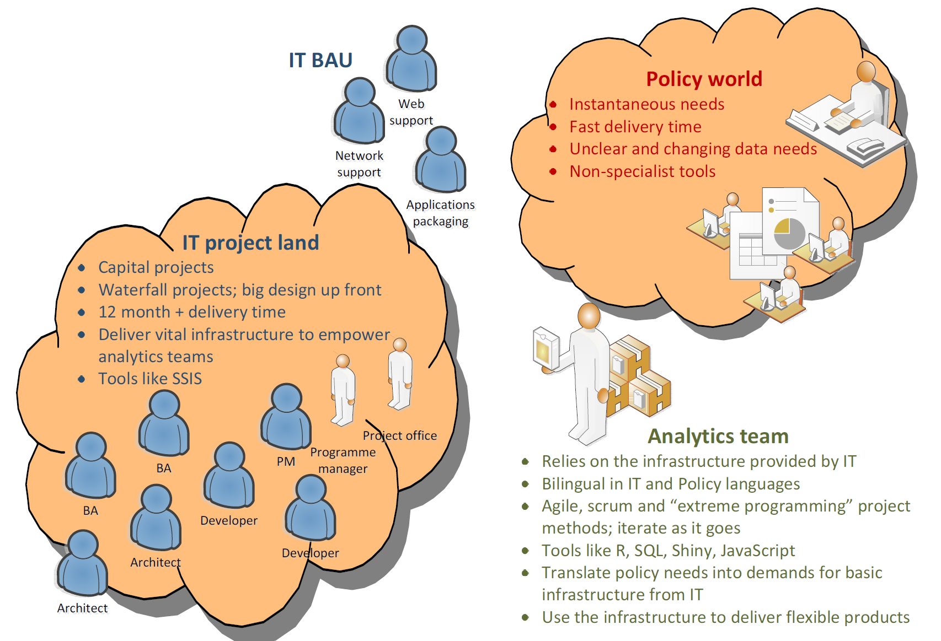
MODERN Analytical teams sit between
Policy World and IT
They USE IT techniques, but they
respond to Policy drivers

Slide 4
“Business Intelligence” inherits
its behavioural characteristics from where it
sits within these two worlds
Policy World
ICT Land
What it inherits
What it inherits
“BIG DATA”: Hadoop, Azure, Other Big Data Systems
Client – Server Solutions With Centralised Access Tightly Connected To Existing Database Systems. Think SAS Enterprise Guide Or R-server.
Managed Data Update Processes, To A Schedule.
Generic Flexible Reporting Tools Focused On Data Access And Querying, Not Subject Matter Content.
A “Uniform” Capability Supported By It – You Don’t Need To Be A Programmer To Report Results.
Quick “Canned” Results That Address 80% Of What You Want.
The Numbers May Change But We Don’t Know Why.
Less Security Risk But Less Content Value
Decentralised highly flexibly, highly adaptive subject-matter specific information solutions that address issue de jure. Think R, Shiny.
Focus is in the communication and the message – what does the world mean?
Skilled Analysts becomes the scarce resource.
Policy groups can differ in Analyst quality.
“World-based” data sources offering multiple perspectives on the same problem.
Data seen as “less secure”. Security breaches more “likely”
Business Intelligence

Slide 5
Subject matter “knowledge” less relevant than specific IT solution
Lots of talk about “the right hammers” but less talk about “the right variable”
High emphasis on control and security.
The best way to stop data breaches is to reduce data access.
High external “confidence” in system but low “data agility”.
Data provider have high “trust” because security, but time-value of data is low because of access
Little appetite for “weekend” solutions of short-duration
Work Characteristics
Capital projects – significant investment
Waterfall projects – big design up front
Lots of people involved
Lots of documentation, system specs
Lots of resources
Long project delivery times (12 months)
Project-based focus: make, deploy, project ends
Software Development Life Cycle: IT is “investment” with long duration before replacement
ICT Land
Effect
Day – to – Day Behaviour Drivers
High Physical Data Security and Highly Controlled Data Access
80 / 20 solutions: aiming to deliver most of the answers to most of the people in a structured way.
Corporate Tools
Solutions built for customers need to be support by IT
IT Project
IT Project
BA
BA
Developer
Developer
Developer
Developer
Architect
Architect
Project
Manager
Technical
Writer
Project
Manager
Technical
Writer

Slide 6
Information NOW is highly valuable
Data’s value diminishes over time
Evidence-base needs to keep a sometimes highly paced and fast-changing world.
The ability to respond is highly important to credibility up and down communication chain.
Communication skills are highly important because the skills-sets are heterogeneous.
Research and Analysis is part of long-term subject-matter learning. But its “structural”, not issue de jure.
Policy World
Work Characteristics
Highly subject matter specific
Narrow focus but deep content (ie: child health, workforce, DHB funding..)
Writing and thinking, writing and thinking
What’s happening in the world?
Does the world align with policy?
Cross government / externally focused communications
Engaging with DHBs and other Govt depts
Heterogeneous skills sets
Doctors, Nurses, Economists, Accountants
Day – to – Day Behaviour Drivers
Responding to Issue De Jure
New Issues THAT DAY make up the bulk of the demand
Need for evidence-based policy
What’s the facts? What’s the evidence? What’s the other bits we don’t know?
Need for context
How did we get here? What’s the “narrative”
Effect
Policy Teams – Content Specific
Policy Teams – Content Specific
Analyst
Principal
Analyst
Senior
Analyst
Analyst
Principal
Analyst
Senior
Analyst

Slide 7
Other Missing Opportunities
Distributed Programming.. Farming out parts of the work to other people to work on different parts of the system simultaneously
Integration Layer
“how do you string everything coherently together?”
Visualisation and Reporting Layer
“how do you get information out to the world?”
UX developer
Working on problem at same time
Web developer
GIT / Github
Customer
Modular Programming
Analytical Layer
“how do you make sense of your data and turn it into information?”
Proprietary
Integration tools
eg. SAS BW Developer
Econometrician
GIS Specialist
Application Layer
“how do you manipulate your data?”
Programmer
System Architect
Data Layer
“how is your data stored and managed?”
DBA
.. If the integration works

Slide 8
Other things you might want but are missing
Technical Training
(Database development and design, computer programming, systems integration,
Web languages)
Analyst Training
Cross Domain Skillsets
(Policy analyst perspective, Accounting perspective,
Legal perspective, Economic perspective)
User Communities of Practice
Team-based Programming
Peer-review?
Subject Matter Development
(Tax Economics, Technical Statistics, Spatial Information, Survey Design)

Slide 9
Modern approach and tool chain
Everything in code
Everything reproducible
Best-in-breed rather than end-to-end IT solutions
Flexible and medium term rather than permanent solutions
Approaches borrowed from software development
Version-controlled
Modular code
Constant peer review / programming in pairs
Continuous or frequent integration
Test-led development
Integrated documentation processes

Slide 10
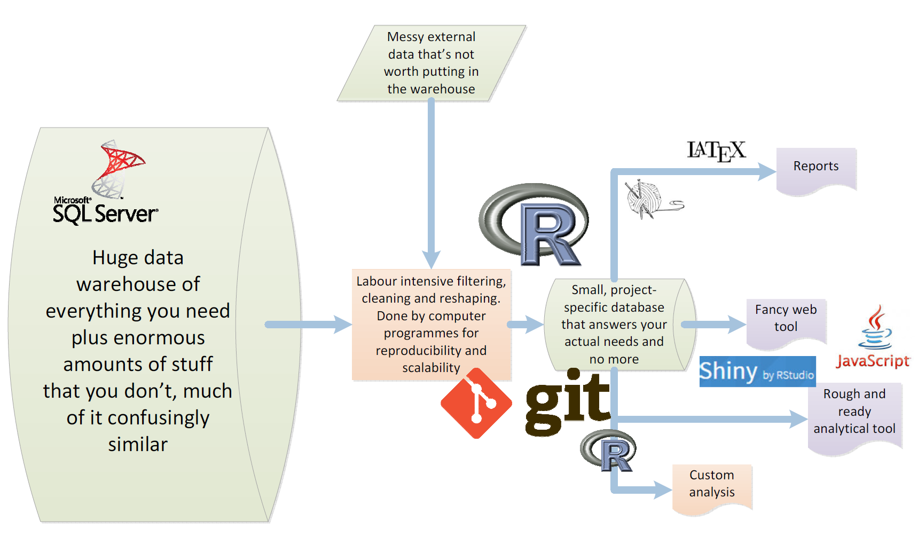
Quick, rapid prototype and development

Slide 11
Keys to success in capability building
Workplace-specific environment, data and problems
Use staff rather than external trainers wherever possible
Create an atmosphere of continuous learning, improvement and change
Well defined, relatively short, sequenced modules
Management and senior management commitment, and acceptance it’s going to get worse before it gets better.
Time.

